Slide 1

European Commission Policies and Initiatives on Accessible Tourism
Antonis Christopoulos
Project Advisor
Sector A1.5 – Competitiveness
Antonis.Christopoulos@ec.europa.eu
Final Conference of project
visits4u
Riga, 7 December 2017

Slide 2
Economic Importance of Tourism
Europe = Nr 1 destination of the world – 620 million international tourist arrivals (2016)
The 3rd largest economic activity in the EU (after distribution and construction)
Dominated by SMEs (>90% = 3.4 million)
Direct and indirect contribution:
        10% of EU GDP
        24 million jobs (10 % of the total labour force)
        20% of the employees in the sector are aged below 25
        Spill-over effects: agro-food, transport, construction, retail, culture, design, etc.

Slide 3
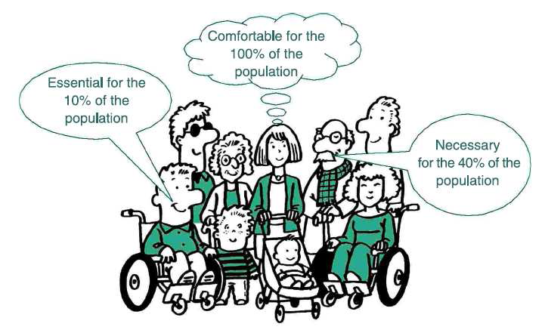
Accessibility in Tourism is…

Slide 4
EU tourism in figures
    Generated €786 billion gross turnover in 2012
    3% of the total EU GDP
    It supports 9 million jobs
    But: only 9% of Europe's tourism services are fully accessible

Slide 5

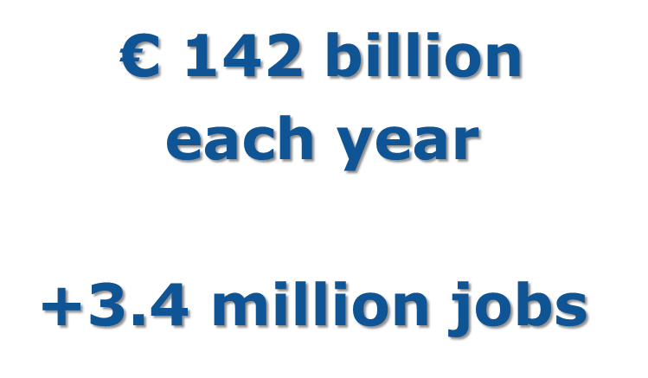
Lack of accessibility is a cost for the tourism sector!

Slide 6
EU Accessible tourism in figures
    An additional 1.2 million enterprises need to provide accessible services to meet future demand
    Improvements could raise its economic contribution by 25%
    … and could attract up top 75% more international travellers

Slide 7
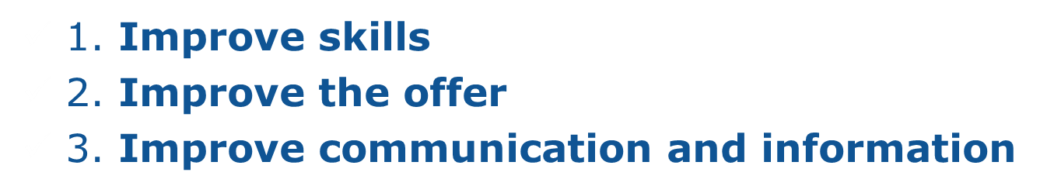
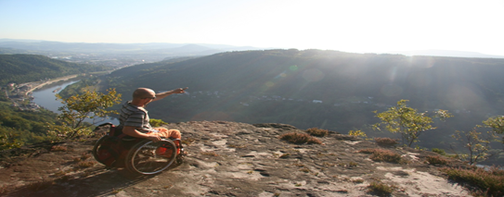
Accessible tourism: what can we do?

Slide 8
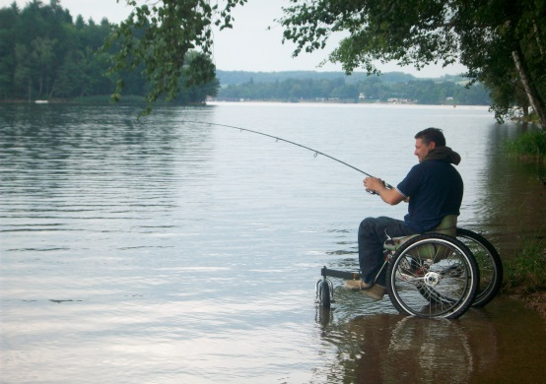
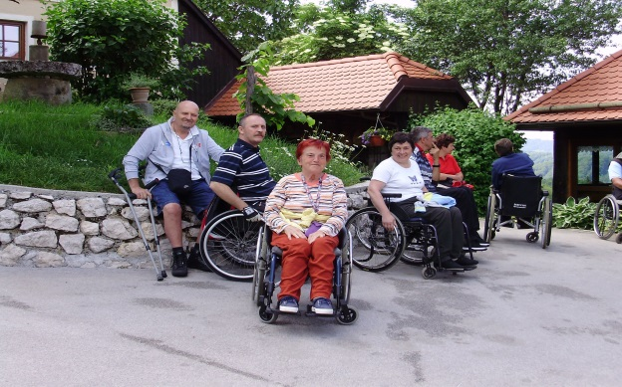
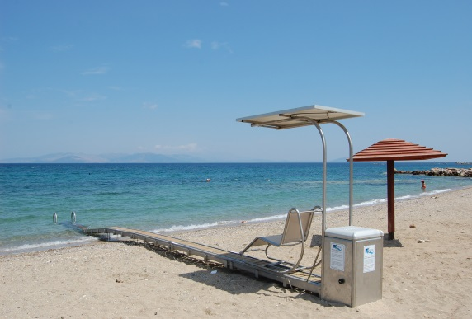
THE EUROPEAN COMMISSION AIMS AT:
increasing accessibility in tourism through a number of actions
raising awareness about the growing importance of the "special needs" market segment
raising the business opportunity profile of "accessible tourism" as it can boost competitiveness

Slide 9
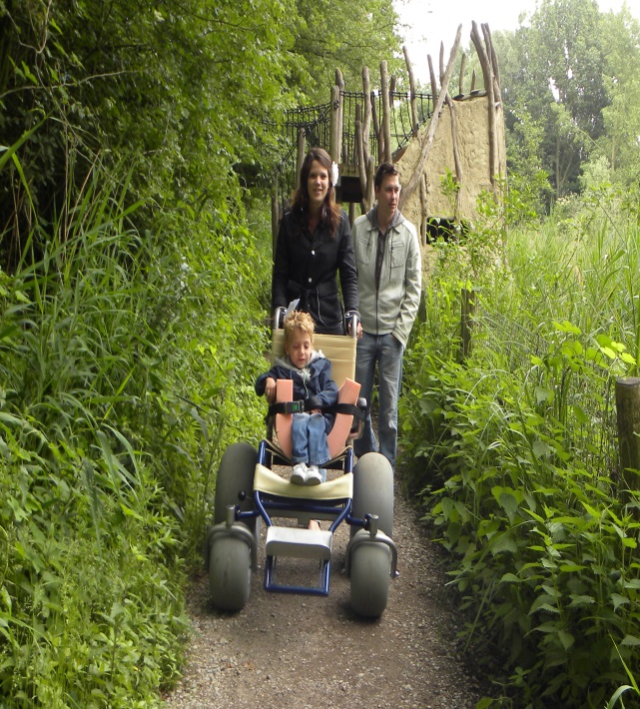
European Commission initiatives related to Accessible Tourism
Calls for tenders for studies
  'Economic impact and travel patterns of accessible tourism in Europe'
  'Improving information on accessible tourism for disabled people'
  ‘Mapping the skills and training needs to improve accessibility in tourism services’

Slide 10
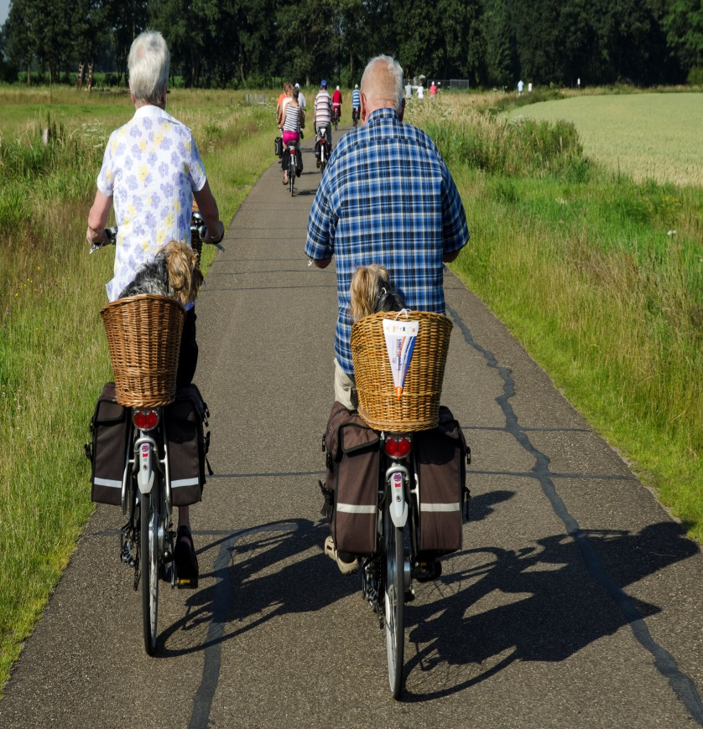
European Commission initiatives related to accessible tourism 2/3
Calls for proposals for co-funding projects
  accessible tourism itineraries
  accessible tourism management and enterpreneurship
  accessible tourism itineraries in outdoor, sport/nature-based and cultural activities

Slide 11
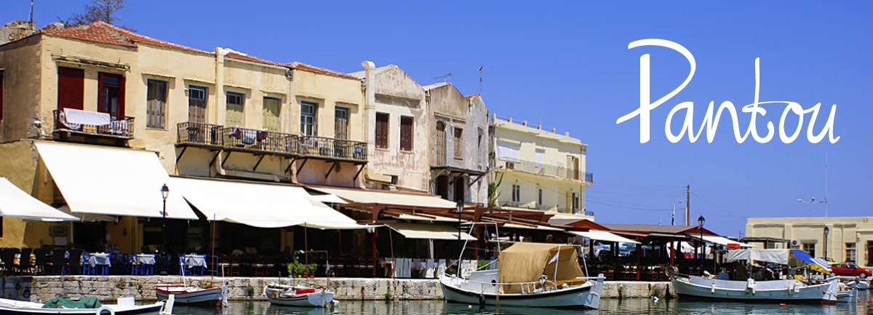
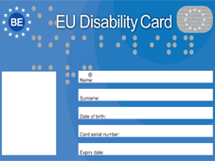
DG GROWTH initiatives related to accessible tourism
European Excellence Awards for Accessible Tourism and Access City Awards
PANTOU: www.pantou.org
EU Disability card
European Accessibility Act
Cooperation with ENAT

Slide 12
Major tourism events 2017-2018
2017 UN Year of Sustainable Tourism for development
2018 EU-China Tourism Year of European Cultural Heritage

Slide 13


THANK YOU
FOR YOUR ATTENTION
European Commission, Tourism website:
http://ec.europa.eu/growth/sectors/tourism/index_en.htm
EASME on Twitter
@H2020EE • @H2020SME • @EEN_EU • @EU_ECOINNO

